Slide 1
Freestyling Pred. Challenge 4
Ali Awari

Slide 2
Looking at the data
10,000 objects, 9 variables
Mostly number ranges with some categorical vars.
GPA, # of Prof. Connections, Earnings, Major, Grad. Year, Height, # of Credits, # of Parking Tickets.
What would happen if we used RPart?

Slide 3
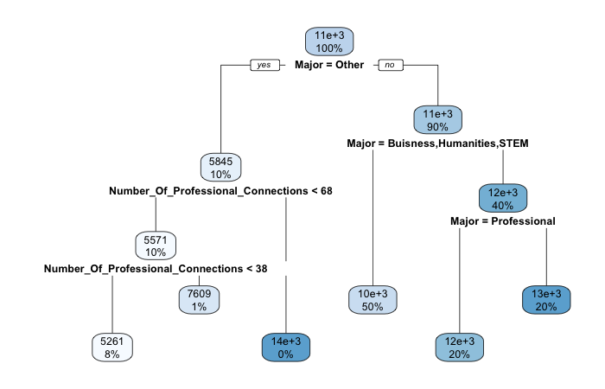
Our first tree
Not very clear at all, low percentages with all leaf nodes.

Slide 4
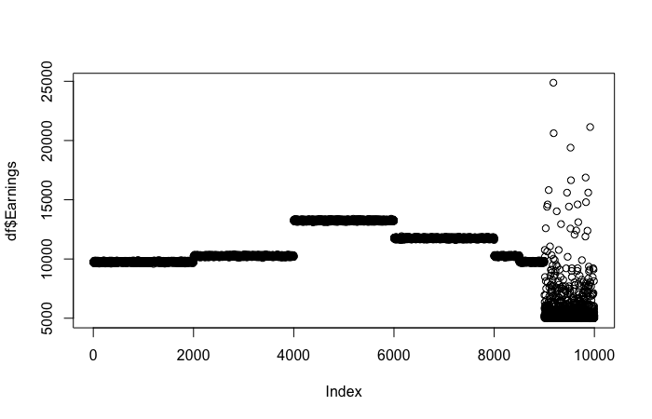
Lets scatter plot the data instead
We can see a large amount of clumping, followed by a column of noise, looks like we need to manipulate our data a little bit.

Slide 5
Bounding ranges
After a little bit of digging through the data, there are obvious clumps in the data (as shown by the scatter).
I separate the data by ranges, and create a new column
0 being noise or data that didn’t truly fit the ranges
1 | 2 | 3 | 4 | 5 | 0
966 | 2503 | 2504 | 2001 | 2004 | 22

Slide 6
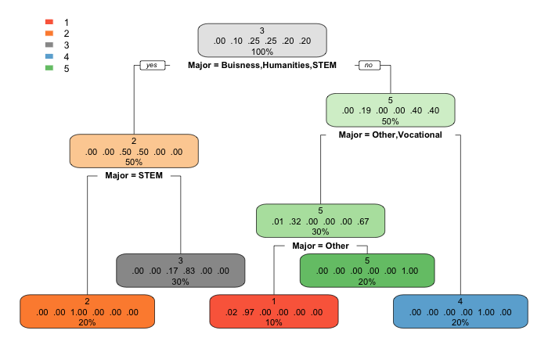
New tree attempt
Great! Now its clear why there was clumping, major has an important role in deciding what range your earnings will be in.
Now we need to find out how to generate the individual numbers in these ranges.

Slide 7
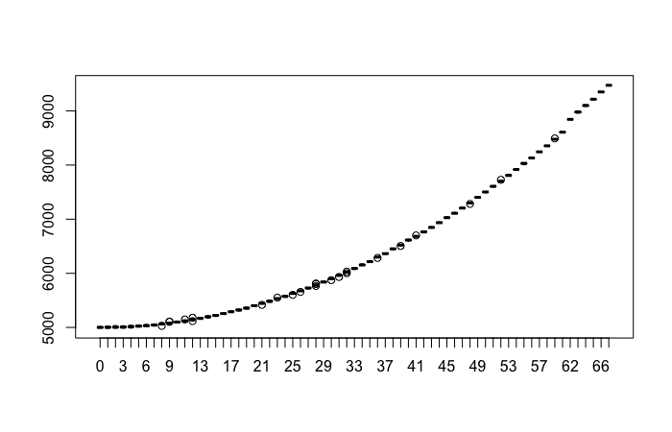
Range 1 “Other”
# Of Prof. Con., is the deciding factor for Range 1.
x^2+x+4984

Slide 8
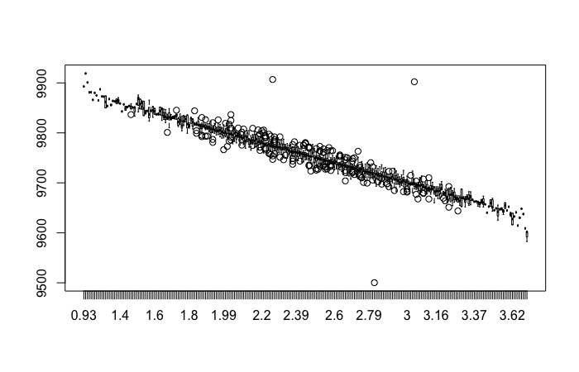
Range 2 “STEM”
Reverse GPA is the deciding factor for Range 2.
-100*x+10000

Slide 9
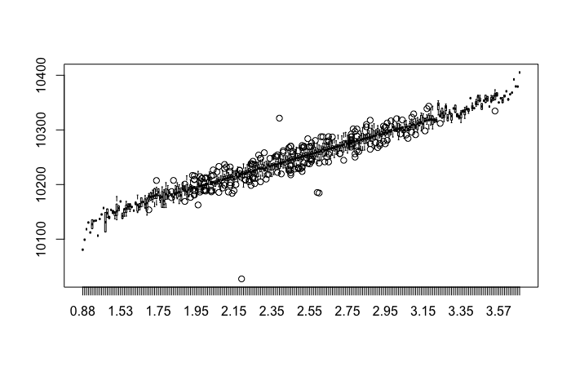
Range 3 “Humanities”
GPA is the deciding factor for Range 3
103*x+9993

Slide 10
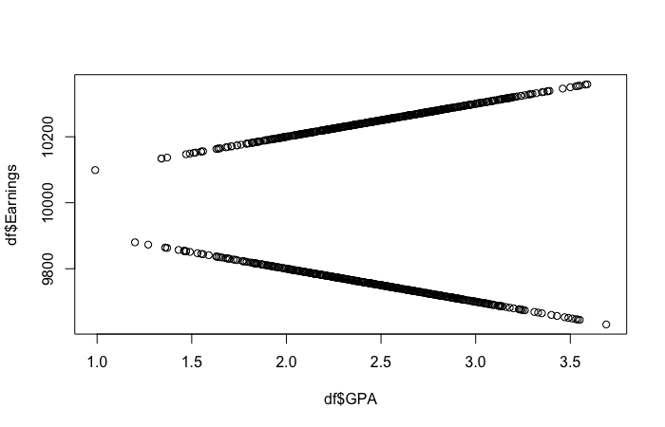
Range 3 Cont. “Buisness”
-100*x+10000 “Buisness” (Odd Graduation Year)
100*x+10000 “Buisness” (Even Graduation Year)

Slide 11
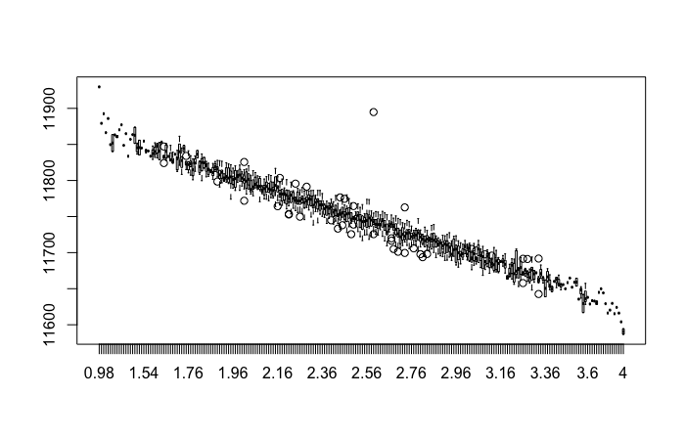
Range 4 “Professional”
Reverse GPA is the deciding factor for Range 4
-100*x+12000

Slide 12
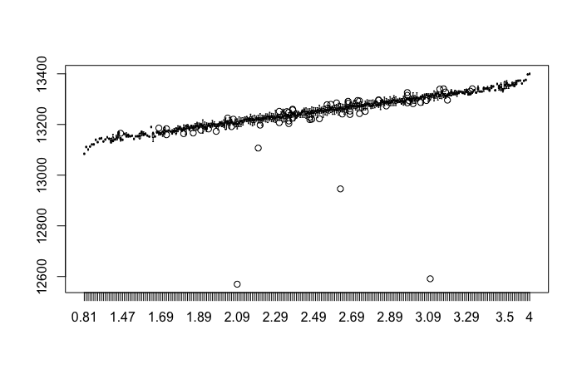
Range 5 “Vocational”
GPA is the deciding factor for Range 5.
100*x + 13000 (with noise added)

Slide 13
Conclusion
Libraries aren’t always the answer
Your advantage is data manipulation and insight
This data was created, there is almost always a pattern

